Slide 1
Module-3
From Deployment to Feedback

Slide 2

Stage-9

Slide 3
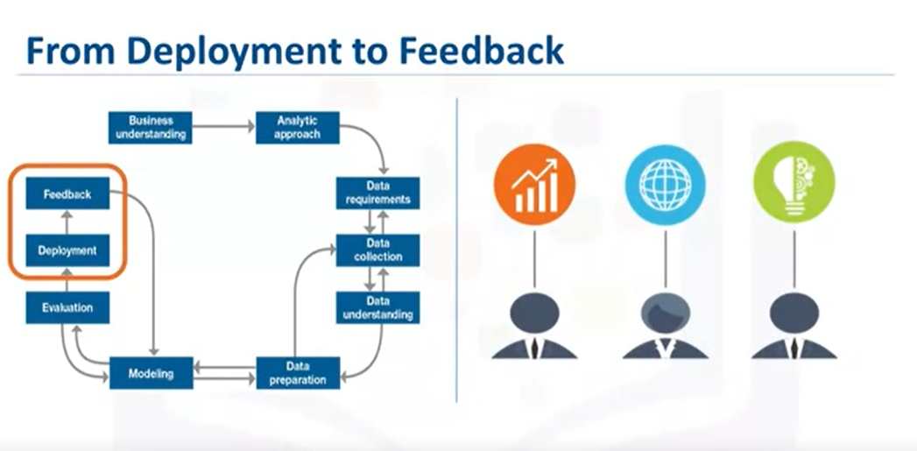
Once the model is evaluated and the data scientist is confident it will work, it is deployed
and put to the ultimate test.
Depending on the purpose of the model, it may be rolled out to a limited group of users
or in a test environment, to build up confidence in applying the outcome for use across the board.

Slide 4
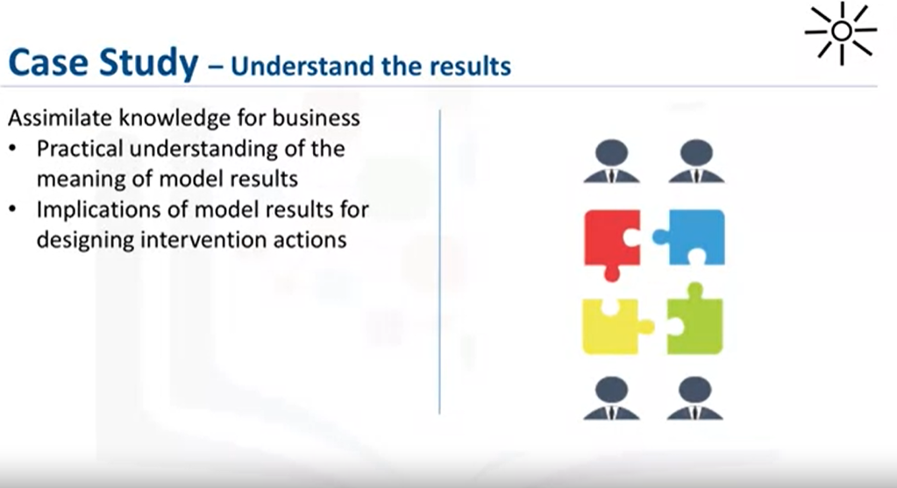
In preparation for solution deployment, the next step was to assimilate the knowledge for the business group who would be designing and managing the intervention program to reduce readmission risk.
In this scenario, the business people translated the model results so that the clinical staff could understand how to identify high-risk patients and design suitable intervention actions.
The goal, of course, was to reduce the likelihood that these patients would be readmitted within 30 days after discharge.

Slide 5
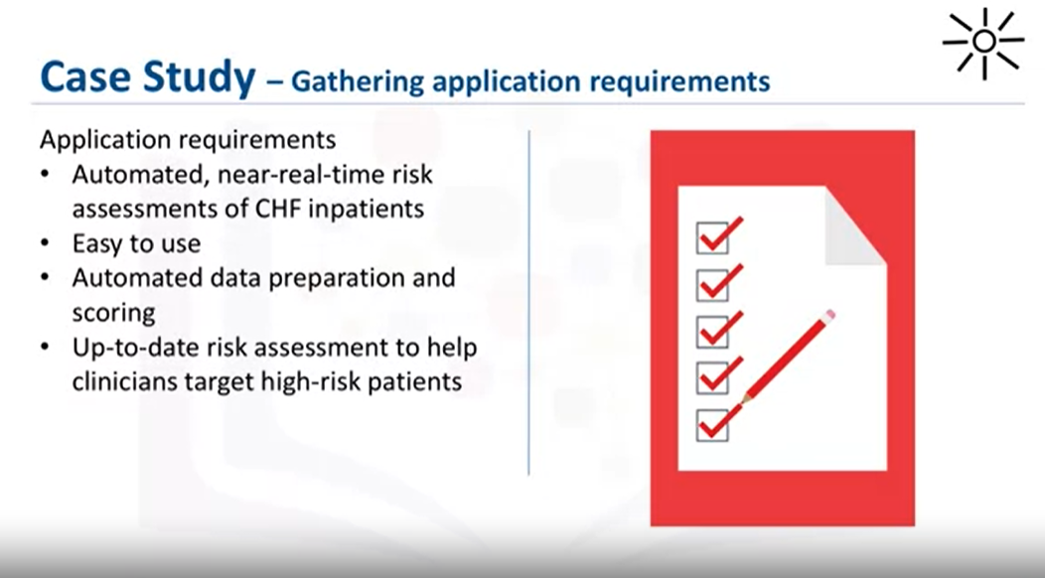

Slide 6
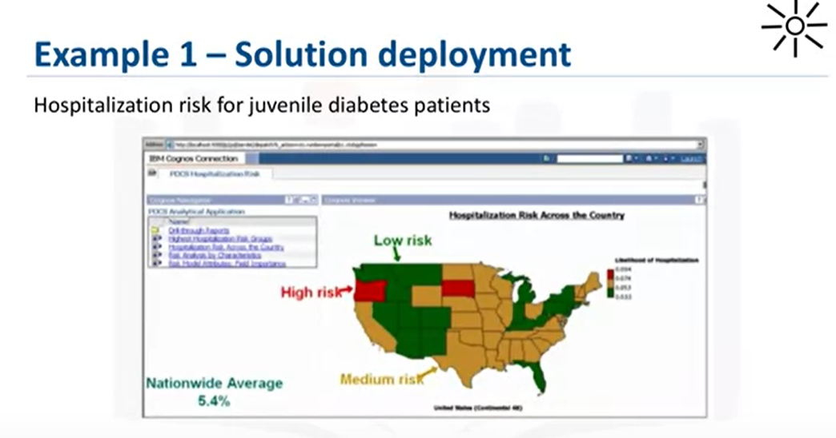

Slide 7

Stage-10

Slide 8
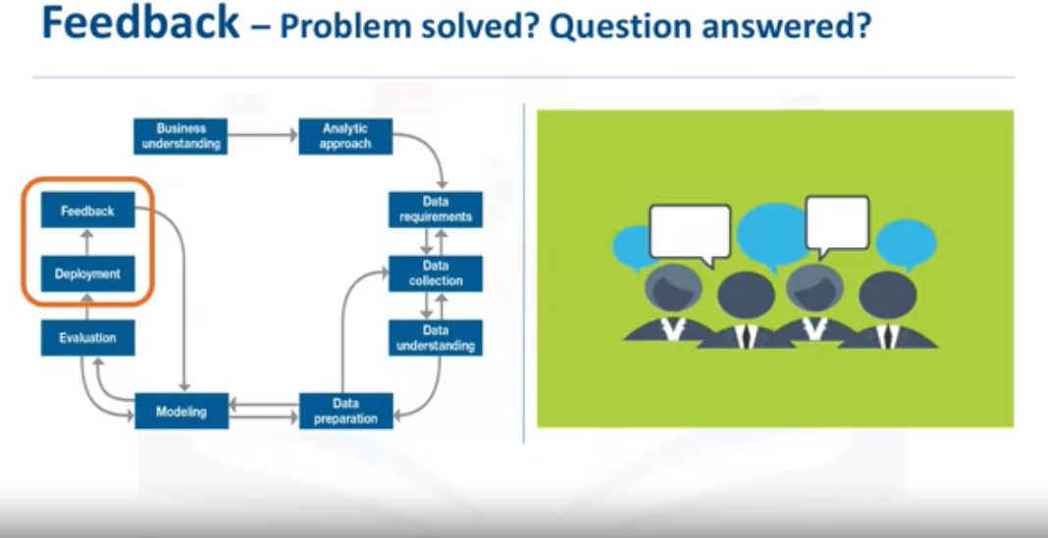
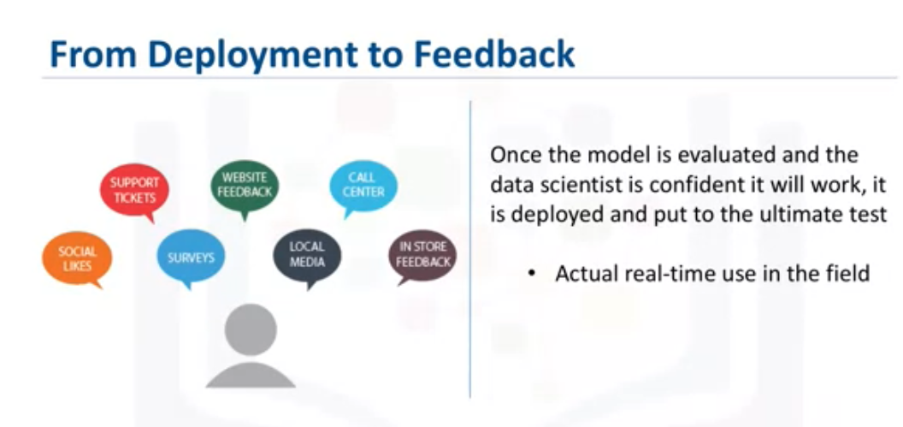

Slide 9
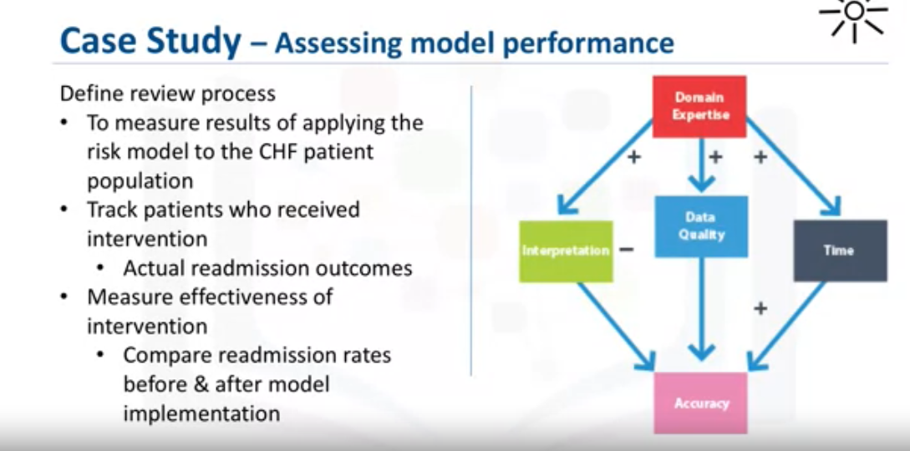
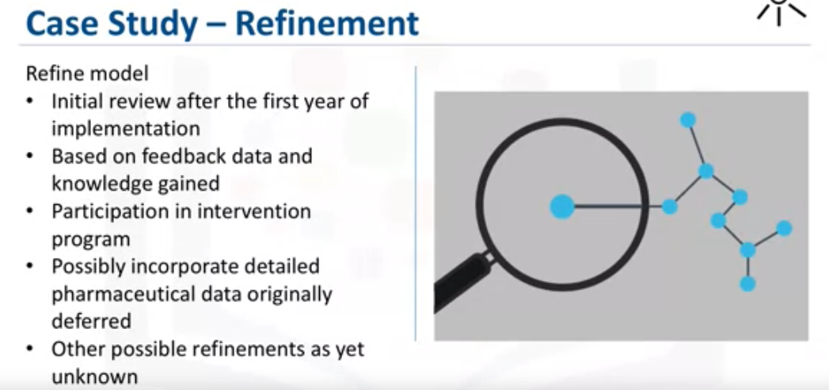

Slide 10
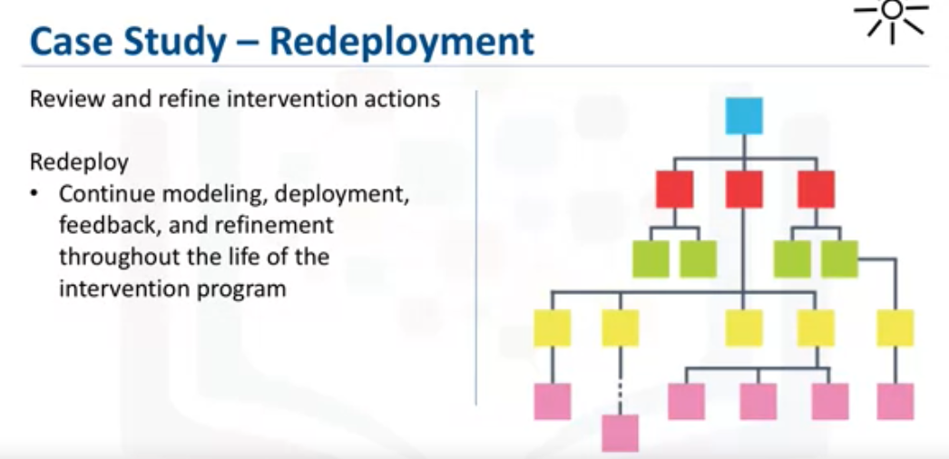

Slide 11
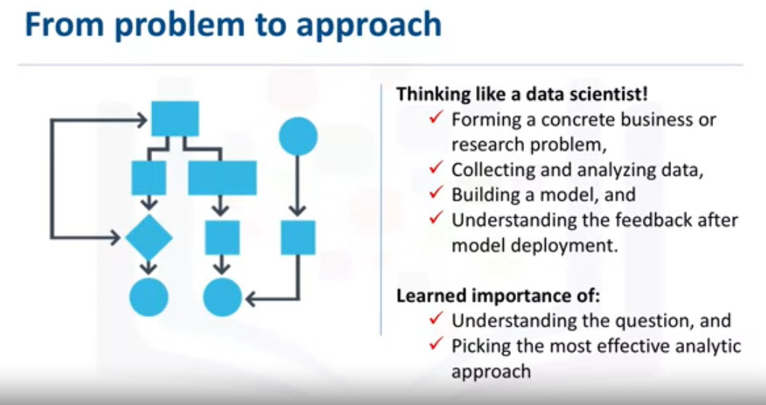

Slide 12
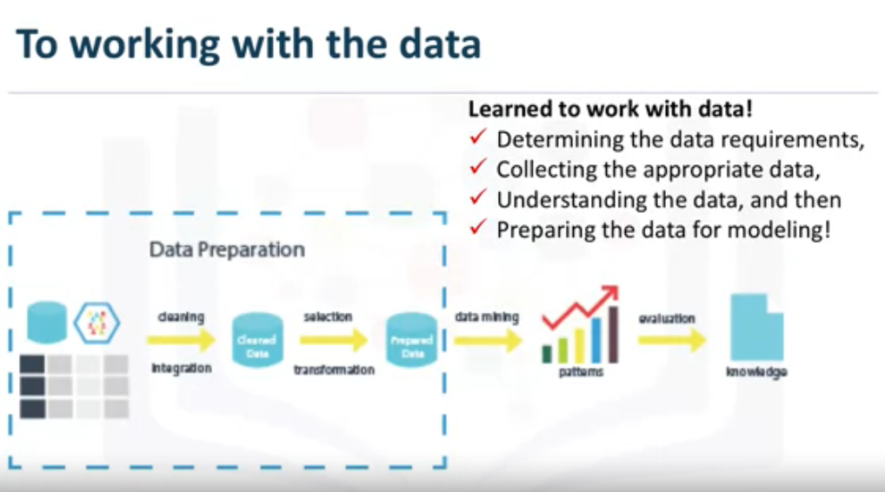

Slide 13
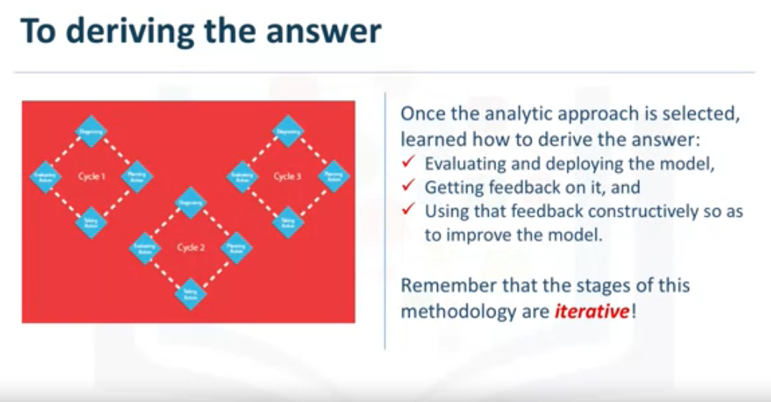

Slide 14
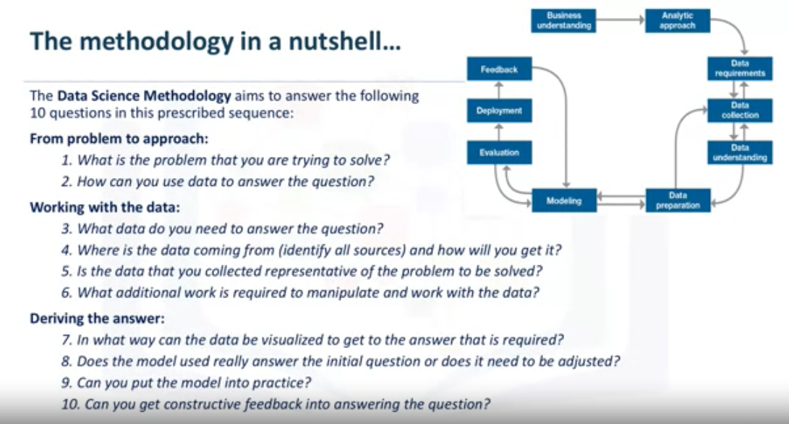

Slide 15
Lesson Summary
The importance of stakeholder input.
To consider the scale of deployment.
The importance of incorporating feedback to refine the model.
The refined model must be redeployed.
This process should be repeated as often as necessary.

Slide 16
Module-3
Final Assignment
Digital Badge

